Slide 1



AI-Assisted Patient Care Navigation for Rural Communities
SWASTHYA PATH
LOGO
Team Name : TECH TITANS
Team Leader Name : KUMAR JAGNYADATTA
Problem Statement : Rural patients need an easy, safe way to navigate from an unstructured health concern to the appropriate care pathway.

Slide 2



Team Members
Team Leader: Name: KUMAR JAGYNYADATTA College: GCEK,BHAWANIPATNA | Team Member-1: Name: KIRAN KUMAR SHARMA College: GCEK,BHWANIPATNA
Team Member-2: Name: LAMBODARA MAHANTA College: GCEK,BHAWANIPATNA | Team Member-3: Name: MK DURGAMADHAB PANDA College: GCEK,BHAWANIPATNA

Slide 3



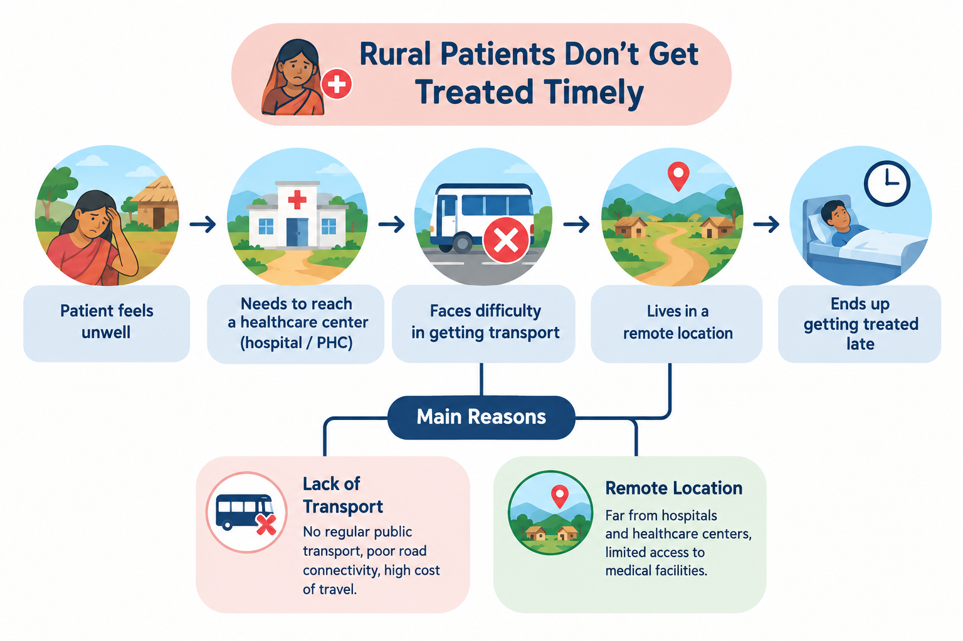

THE PROBLEM LANDSCAPE
Rural patients lose time getting care
CRITICAL SHORTAGE OF DOCTORS
Rural and semi-urban hospitals have only half of sanctioned doctor posts filled, so local and specialist care is harder to get.
ECONOMIC & PHYSICAL BURDEN
Daily-wage workers and farmers may lose a day's pay and spend money traveling for care.
COMPOUNDING INFRASTRUCTURE DELAYS
Poor roads, weak connections, missing specialists, and out-of-stock medicines cause delays and wasted trips.

Slide 4
HACKVERSE 2026 · HEALTHCARE INNOVATION
Swasthya Path
Low-bandwidth access to rural care in many languages
Help patients check for a clinician, records, and medicines before traveling.
LOW-BANDWIDTH FIRST
MULTILINGUAL & VOICE
CLINICIAN-LED TRIAGE
Service adjusts to connection; records work offline
Support in many languages,
with help when needed
Triage helps;
clinicians make decisions

Slide 5
3. Opportunity, Differentiation & USP
We complement existing telemedicine infrastructure instead of duplicating it.
THE PROBLEM
Patients often begin with an unstructured concern:
“I’m not feeling well.”
They may not know the urgency, care pathway, or what information to provide.
OUR APPROACH
Conversational intake
→ structured symptoms
→ care-pathway navigation
→ consultation preparation
→ follow-up
USP
Patient-side care navigation
• Starts with the patient’s problem, not a service choice
• Local-language / voice-ready
• AI assists; doctors decide
• Safety-first escalation
• Designed to work alongside existing healthcare services

Slide 6
PATIENT-TO-CARE FLOWCHART
One connected journey from patient to care
STEP 01 · ACCESS
STEP 02 · INTAKE
STEP 03 · SAFETY
STEP 04 · TRIAGE
STEP 05 · CLOSURE
Language Choice
Symptom Entry
AI Urgency Check
Book Clinician
Verify Stock
Choose a language; text uses less data.
Share symptoms by text or voice securely when connected.
When connected, triage flags urgent symptoms for a clinician or emergency care. AI needs a connection.
Find and book an available doctor when connected; online visits need a connection.
Check pharmacy stock online before traveling; it may change.

Slide 7
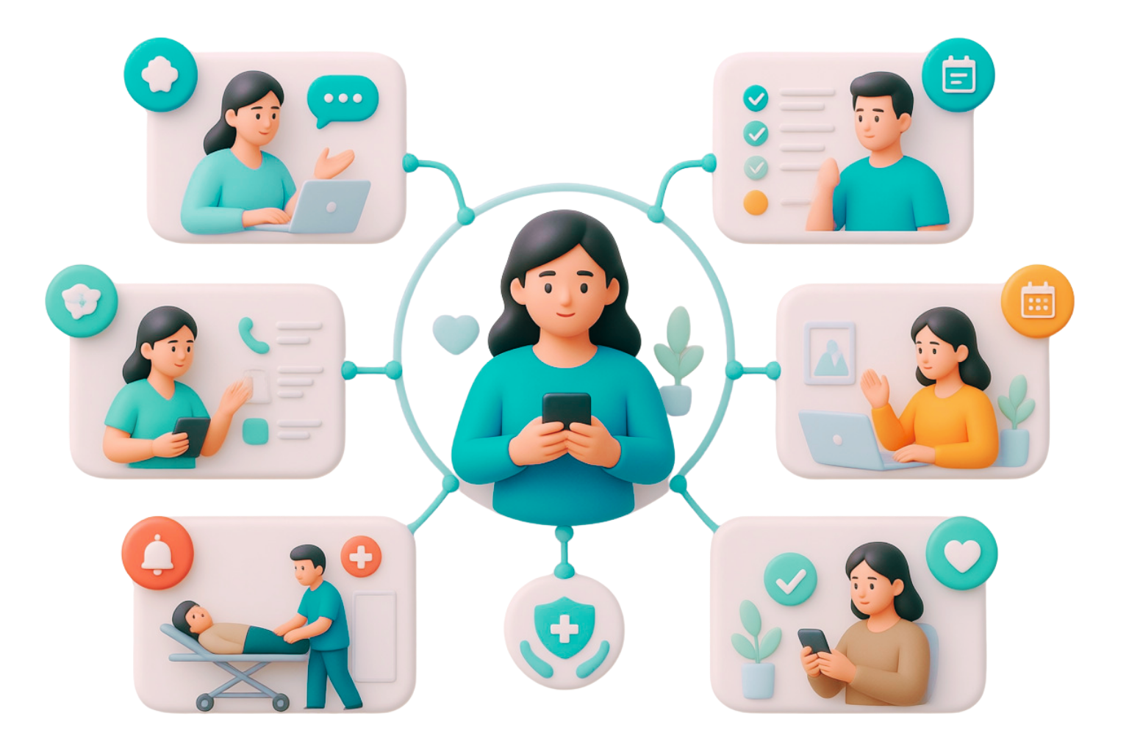
5. Process Flow Diagram
The system begins with the patient’s concern and routes toward the appropriate care pathway.
PATIENT
“I’m not feeling
well.”
CONVERSATIONAL
INTAKE
Natural language / voice
STRUCTURE SYMPTOMS
Duration • severity • warning signs
CARE NAVIGATION
Emergency / physical care / teleconsult / routine
🚨 EMERGENCY
Immediate physical care
🏥 ROUTINE PATH
Appropriate guidance / monitoring
👨‍⚕CONSULTATION
️ Teleconsult / healthcare professional
Doctor’s advice → care plan → follow-up → escalation if symptoms worsen
Safety principle: AI is an intake/navigation aid, not a replacement for medical diagnosis or emergency care.

Slide 8




LOW-BANDWIDTH PLATFORM ARCHITECTURE
Care adapts to the connection; records are available offline.
CONNECTED CARE
LIMITED BANDWIDTH
INTERMITTENT OR NO CONNECTION
Video visits with available doctors and specialists; symptom checks that use little data.
Text-first intake, small data requests, and adjusted audio/video quality.
Digital records work offline; live visits, AI triage, and pharmacy updates need a connection.
Honest boundary: Service adjusts to the connection; only records work offline, not high resolution interaction .

Slide 9
STAKEHOLDER & SERVICE INTEGRATION
Patients, clinicians, and pharmacies work together in one care pathway
Local staff help patients connect to care. Current schedules and pharmacy stock help them check before traveling. Updates need partner systems and a connection.
PATIENT ACCESS
DOCTOR SCHEDULES
PHARMACY UPDATES
CARE COORDINATION
Patients & local staff
Available clinicians & specialists
Nearby medicine availability
Hospital staff & administrators
Intake in many languages, by voice, or with help for people who have trouble reading.
Partner pharmacies send current stock updates; check availability before traveling.
Show current doctor schedules and open appointments when connected.
Coordinate referrals, schedules, and records across local facilities.
Offline-accessible recordsrecords are the only item that must work offline; live schedules and pharmacy data need a connection.
Integration boundary: current stock and schedule information depends on partner participation and timely updates.

Slide 10
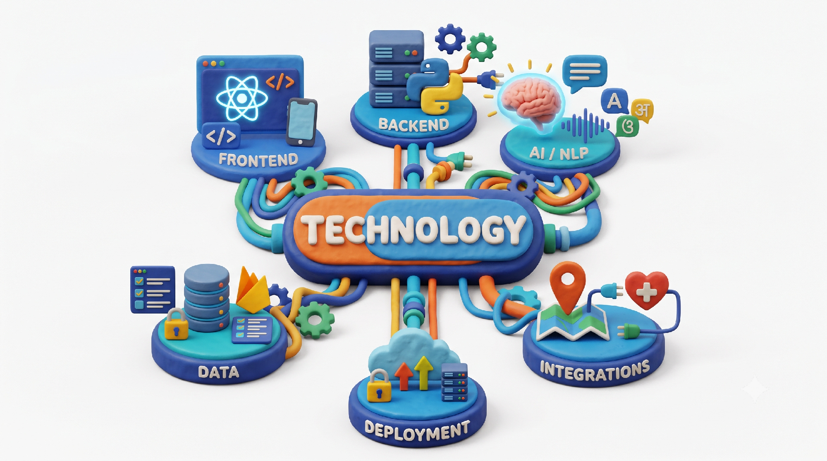
8. Technologies to be Used
Frontend
React / Next.js
Responsive mobile-first UI
Backend
Python + FastAPI
REST APIs
AI / NLP
LLM / NLP
Speech-to-text
Odia / Hindi / English
TECHNOLOGY
Data
PostgreSQL or Firebase
Consent + structured summaries
Deployment
Cloud hosting
HTTPS + authentication
Integrations
Maps / location
Telehealth APIs where officially available
Security considerations: encryption, minimal data collection, role-based access, consent management and secure API communication.

Slide 11
9. Estimated Implementation Cost
Hackathon prototype estimate; production healthcare deployment would require a separate assessment.
Frontend hosting
₹0 – ₹1,000
Backend / cloud
₹0 – ₹2,000
Database
₹0 – ₹1,000
AI / API usage
₹1,000 – ₹3,000
Domain / services
₹0 – ₹1,000
ESTIMATED PROTOTYPE TOTAL: ₹2,000 – ₹8,000
Production cost depends on user volume, healthcare integrations, security/compliance and cloud infrastructure.

Slide 12
REGULATORY & CLINICAL STANDARDS
Official sources for the solution
NATIONAL GUIDELINES & PLATFORMS
DIGITAL HEALTH & GLOBAL STRATEGY
Telemedicine Practice Guidelines — Ministry of Health and Family Welfare / eSanjeevani
Ayushman Bharat Digital Mission
WHO Global Strategy on Digital Health
WHO Consolidated Telemedicine Implementation Guide
These sources support the proposed solution and explain how to put it in place; they do not mean Telehealth Bridge already exists.

Slide 13

SWASTHYA PATH
We are not building another telemedicine platform.
We are building a patient-side navigation layer around the healthcare journey.
FROM “I’M NOT FEELING WELL” TO “I KNOW WHAT TO DO NEXT.”
THANK YOU

